Slide 1
Nutrition Food
Android App

Slide 2
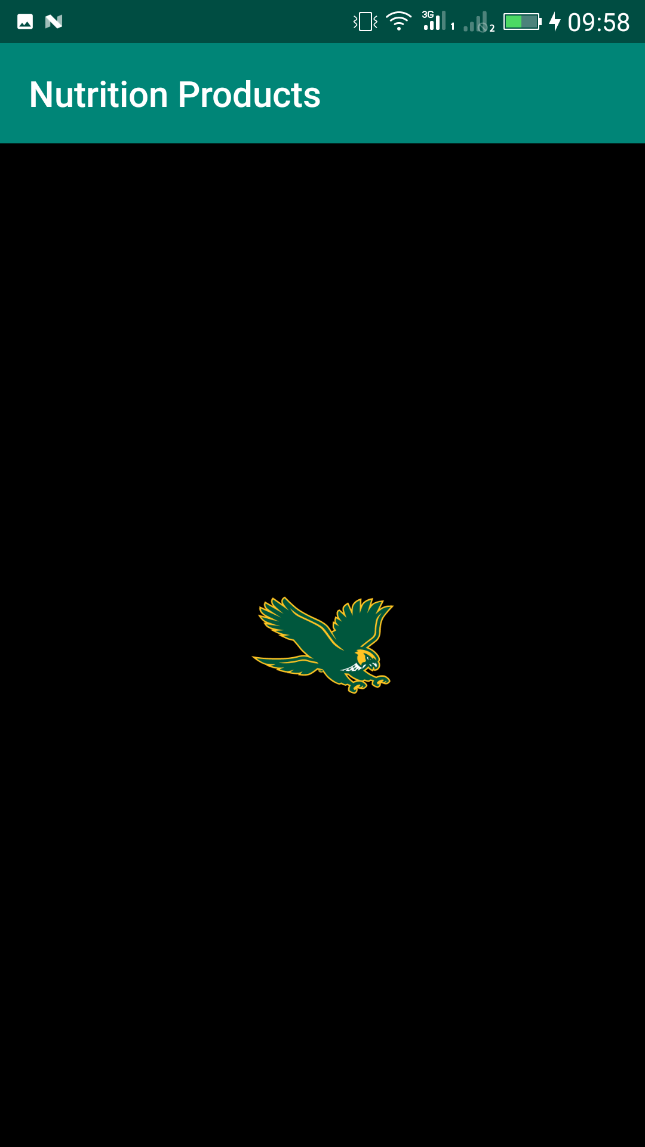
Splash Screen
Splash Screen
Background: Black
Imageview in front

Slide 3
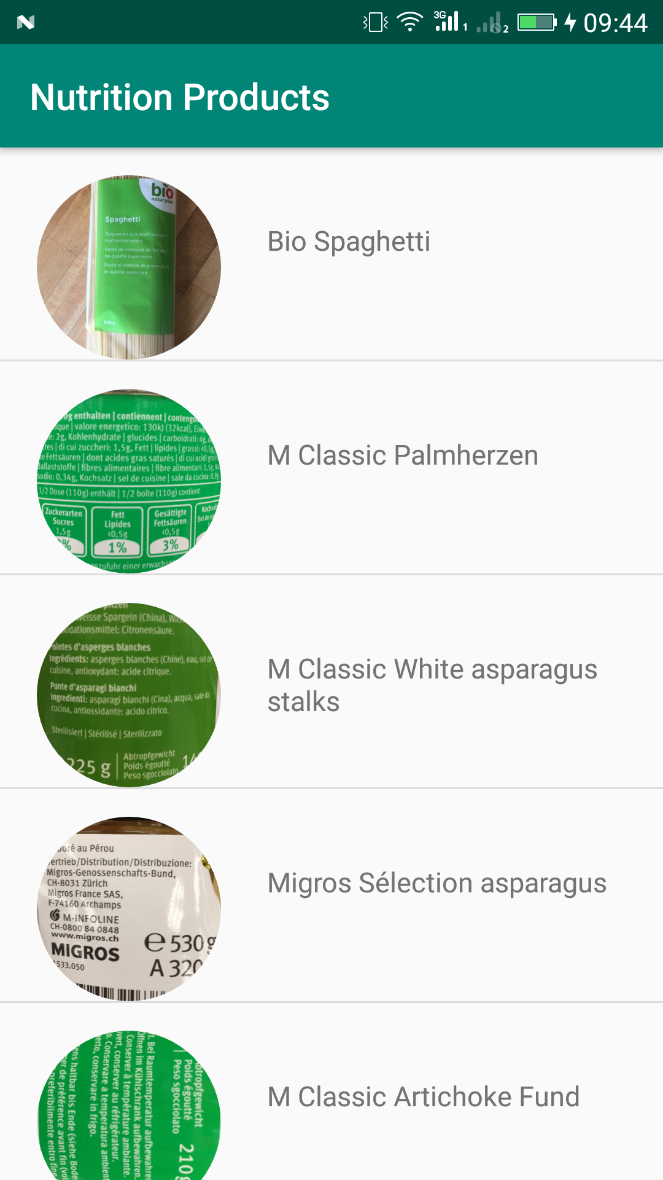
Main Page
Main page consist of the list of all the products
Used HttpHandler to make a service call to the API
Used Json Objects to retrieve the data from Json File
setRoundAsCircle(“true”) to make the images round.
ListView to Display data in the form of list

Slide 4
Main Page(Continue..)
implementation 'com.facebook.fresco:fresco:2.0.0’
Used Fresco Library
This library use the internet data once to load the images
Once the Images are loaded, it will not take more loading processes

Slide 5
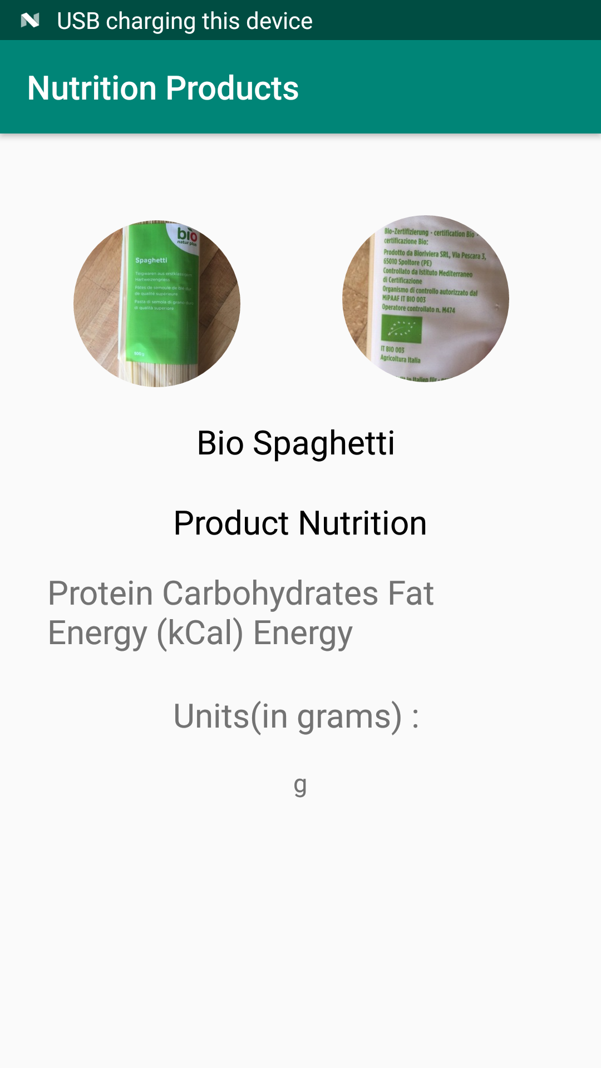
Description Page
Description Page Shows the front and back image of the product.
Here data Contain:
Product Name
Product Nutrition
Quantity

Slide 6
Thank you

